Slide 1
Systems Analysis and Design CT026-3-1
Deployment and Maintenance

Slide 2
Topic & Structure of The Lesson
Deployment
System Changeover Strategies
Maintenance

Slide 3
Learning Outcomes
By the end of this lecture, YOU should be able to :
Discuss different types of deployment
Discuss different types of maintenance

Slide 4
Key Terms you must be able to use
If you have mastered this topic, you should be able to use the following terms correctly in your assignments and exams:
Deployment
System Deployment Plan
System Change-over Strategy
Maintenance
Corrective Maintenance
Adaptive Maintenance
Perfective Maintenance
Preventive Maintenance

Slide 5
System Deployment
Activities that make a software system available for use
System is ready to be delivered to owner / customer
System fully tested and fully functional.
Production site / pre-deployment test
To conduct ‘Post-deployment’ test (on-site testing)
Owner / customer are informed about the deployment
aka; product release / launching.

Slide 6
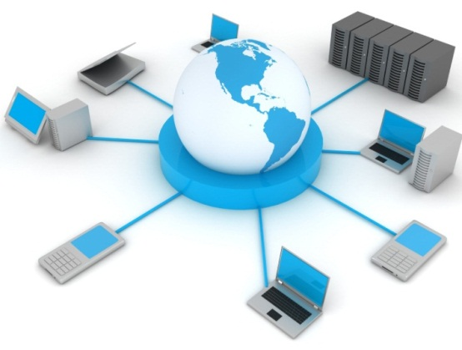
System Deployment Plan
Determining Deployment Options
Where will the system / software will be delivered?
Packaging Software / Systems
What and how the components will be delivered to the users?
Deployment Scheduling
Inform stakeholders of deployment event, who and when?
System change-over strategies
How the old system will be replaced with new?
Integrating System Components
Installing equipment / connecting servers, etc
Post-Deployment (On-Site) Testing
Provide Training to users (if needed)

Slide 7
Determining Deployment Options (Where will the system be delivered?)
Upload to Web Server / Web Host
Website / web applications
Software patches / plug-ins, etc
Upload to Web Store
Mobile applications, games
Burn to DVD
Off-shelf applications
Console games
Install in customer’s local servers
Customized Business Systems / applications
Security Systems
Database

Slide 8
Packaging Software / Systems (Operations to prepare a system for assembly and transfer to the customer site)
Converting / securing source codes
Preparing SETUP or INSTALL files
Compress files
Burn to installation disks
OR prepare to upload to server
Prepare User Manual
Prepare Technical Manual

Slide 9
Deployment Scheduling (Inform stakeholders of deployment event)
For cloud-based system
Plan to backup old system files in cloud
Plan upload / update new system to cloud (date, duration)
Plan ‘fall-back’ time
For local system installation at user’s place
Identify all stakeholders involved in deployment
Inform relevant users of installation date and time
Ask to backup all ‘old’ files
Standby system support personnel
Instruct local servers to be ‘off-line for maintenance’
Plan ‘Fall-Back’ time

Slide 10
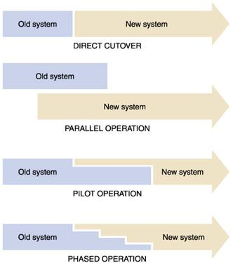
System Change-over Strategies (How the old system will be replaced with new?)

Slide 11
Integrating System Components (Installing equipment / connecting servers, etc)
Connecting sub systems to main systems
Connecting database
Connecting new system to other local system (legacy systems)
Installing security components
Firewall
User profiles (administrator access)

Slide 12
Post Deployment (On-Site) Test
Running test to spot new problems after deployment
Develop Test
Technical Tests
Connections Tests
Security Tests
User Test
User Acceptance Test

Slide 13
User Training
Applicable for large / complicated systems.
Training Administrators
Content Management
Maintenance of the system
Training End-Users
Common User functions
Training Technical Support
Fixing common problems

Slide 14
Other Activities of System Deployment
License Activation
EULA (End User License Agreement)
Corporate License
Connecting new system to backup machines
Connecting to Disaster Recovery Centre (DR)

Slide 15
Software Maintenance
The process of modifying a software system or component after delivery to correct faults, improve performance or other attributes, or adapt to a changed environment

Slide 16
Maintenance Tasks
Maintenance expenses
Vary significantly during the system’s operational life and include spending to support maintenance activities
Maintenance activities
Programs, procedures or documentation to ensure correct system performance
Adapt the system to changing requirements
Make the system operate more efficiently

Slide 17
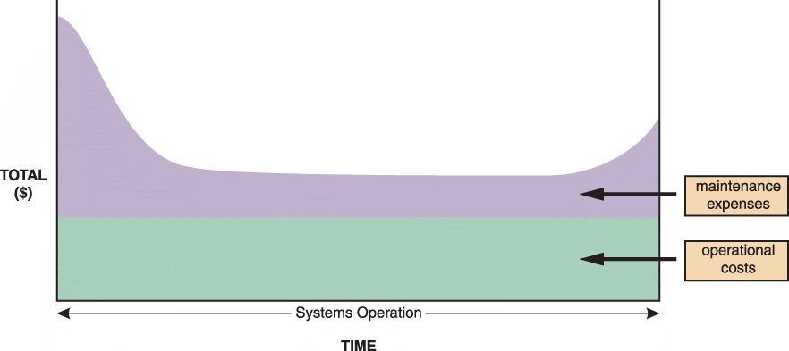
Maintenance Tasks
FIGURE 12-4 The total cost of operating an information system includes operational and maintenance costs. Operational costs (green) are relatively constant, while maintenance costs (purple) vary over time

Slide 18
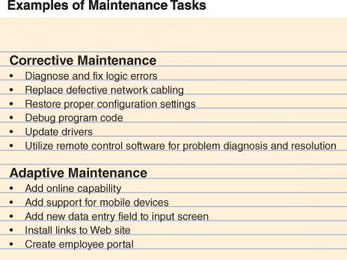
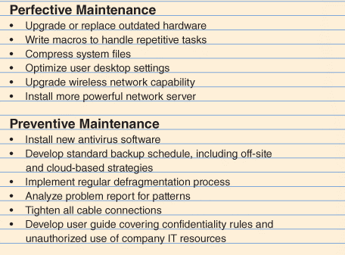
Maintenance Tasks
FIGURE 12-5 Corrective maintenance fixes errors and problems. Adaptive maintenance provides enhancements to a system. Perfective maintenance improves a system’s efficiency, reliability, or maintainability. Preventive maintenance avoids future problems

Slide 19
Maintenance Tasks
Corrective Maintenance
Diagnoses and corrects errors in an operational system
Respond to errors in various ways, depending on nature
Worst-case situation is a system failure
When the system is operational again, the maintenance team determines the cause, analyzes the problem, and designs a permanent solution

Slide 20
Maintenance Tasks
Adaptive Maintenance
Adds enhancements to an operational system and makes the system easier to use
The procedure for minor adaptive maintenance is similar to routine corrective maintenance
Can be more difficult than new systems development because the enhancements must work within the constraints of an existing system

Slide 21
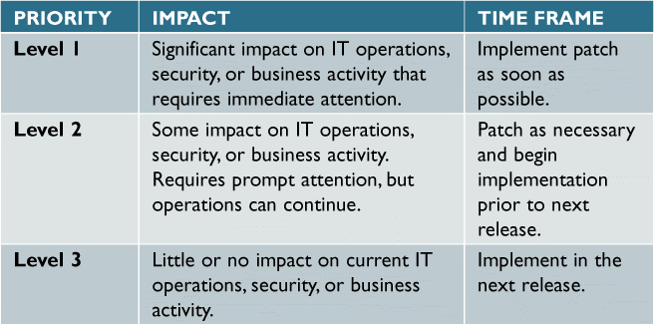
Maintenance Tasks
Adaptive Maintenance
FIGURE 12-7 This three-level ranking framework for IT support considers potential impact and response urgency

Slide 22
Maintenance Tasks
Perfective Maintenance
Involves changing an operational system to make it more efficient, reliable and maintainable
Cost-effective during the middle of the system’s operational life
Programs that need a large number of maintenance changes usually are good candidates for reengineering
The more a program changes, the more likely it is to become inefficient and difficult to maintain

Slide 23
Maintenance Tasks
Preventive Maintenance
Requires analysis of areas where trouble is likely to occur
IT department normally initiates preventive maintenance
Often results in increased user satisfaction, decreased downtime
Sometimes does not receive the high priority that it deserves

Slide 24
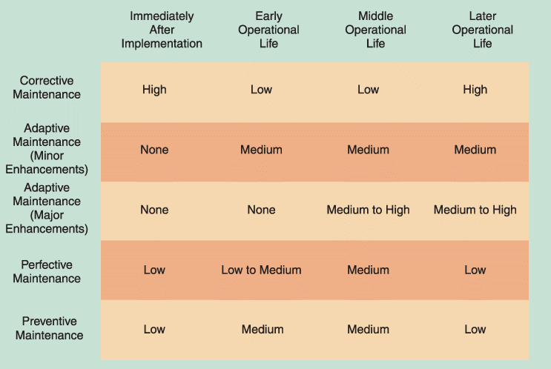
Maintenance Tasks
FIGURE 12-6 Information systems maintenance depends on the type of maintenance and the age of the system

Slide 25
Maintenance Management
The Maintenance Team
System administrator
Manages computer and network systems
Systems analysts
Investigate and rapidly locate the source of a problem by using analysis and synthesis skills
Programmers
Applications programmers work on new systems development and maintenance
Systems programmers concentrate on operating system software and utilities
Database programmers focus on creating and supporting large-scale database systems
Organisational issues
Maintenance team vs. new systems development team

Slide 26
Maintenance Management
Maintenance Requests
Involve a series of steps
All work must be covered by a specific request
Initial determination
The systems review committee
Task completion
User notification

Slide 27
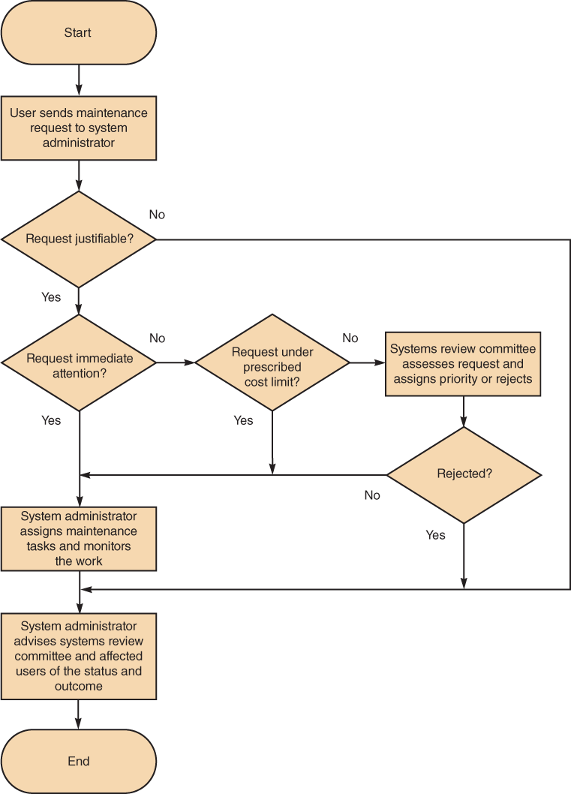
FIGURE 12-10 Although the procedure varies from company to company, the chart shows a typical process for handling maintenance requests

Slide 28
Maintenance Management
Initial Determination
System administrator makes the initial determination if are justifiable
The System Review Committee
Either approves the request and assigns a priority to it, or rejects it
Task Completion
System administrator usually assigns tasks to individuals or to a maintenance team
User Notification
Users who initiate maintenance requests expect a prompt response, especially if the situation directly affects their work

Slide 29
Maintenance Management
Establishing Priorities
In many companies, systems review committee separates maintenance requests from new systems development requests
Some IT managers believe that evaluating all projects together leads to the best possible decisions
Object is to have a procedure that balances new development and necessary maintenance work

Slide 30
Quick Review Question
What are the four maintenance tasks?

Slide 31
Summary of Main Teaching Points
Deployment
System Deployment Plan
System Change-over Strategy
Maintenance
Maintenance tasks
Maintenance Management

Slide 32
Question and Answer Session
Q & A

Slide 33
What we will cover next
Revision

